Slide 1

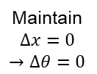


Pilot Foot
Maintain $∆F=0$
Pilot Force
Ground
Suit Force
Forward Proximity
Maintain
$$∆x=0$$
$$→∆θ=0$$
$$x_{Forward}$$
Pilot Thigh
Rear Proximity
$$x_{Rear}$$
Pilot Shin

